Slide 1
Chapter 5: Dynamic Analysis-Test Design Techniques
Software Testing
Statement and Decision Coverage Testing

Slide 2
Statement Coverage Testing:
Statement :
- 'An entity in a programming language, which is typically the smallest
indivisible unit of execution' (ISTQB Def).
Statement coverage:
- 'The percentage of executable statements that has been exercised by a
test suite‘. (ISTQB Def)
Test Coverage:
- Test coverage measures the amount of testing performed by a set of tests.
Coverage = (Number of coverage items exercised/Total number of coverage
items) * 100

Slide 3
White Box Testing Techniques
Statement Coverage Testing:
White box test design technique
Execute all or selected statements of the test object
Traverse all statements at least once
Covers only the true conditions.
What the source code is expected to do and what it should not.
Statement coverage: If the test case executes every line of code in the program, it is called 100% statement coverage.
Drawback of this technique is that we cannot test the false condition in it.

Slide 4
Statement Coverage Testing
Translate the source code into a control flow graph.
Statements are represented as nodes (circles)
Control flow between the statements is represented as edges
(connections).
Sequences of unconditional statements are illustrated as one single node
Unreachable code can be detected
Empty ELSE-parts are not considered

Slide 5

Statement Coverage Testing
Test Requirements= Statements in the program
*100
Test Completeness criteria (% of the statements in the software which were
executed atleast once)
How 100% statement coverage can be achieved?
Aim is to achieve the maximum amount of statement coverage with the minimum
number of test cases
In some situation one test case can also be enough
Statement coverage is also called C0- coverage/measure

Slide 6
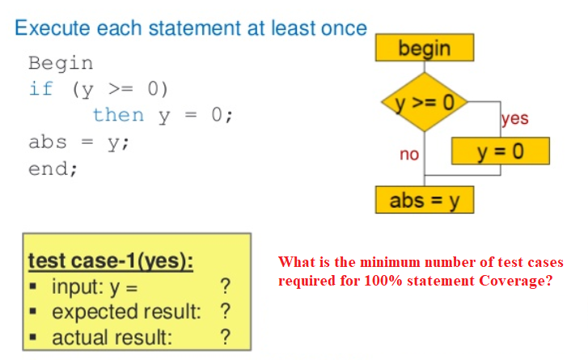
Statement Coverage Testing Example 1

Slide 7
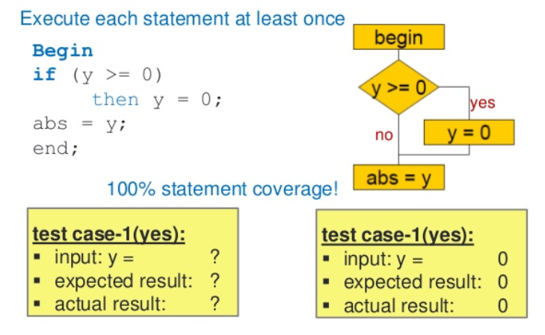
Statement Coverage Testing Example 1

Slide 8
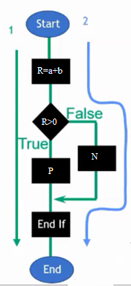
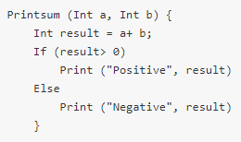
Statement Coverage Testing Example 2
TC#1:
If A = 3, B = 9
Number of executed statements = 5
Total number of statements = 7
*100
Statement Coverage: 5/7 = 71%

Slide 9
Statement Coverage Testing Example 2
TC#2:
If A = -3, B = -9
Number of executed statements = 6
Total number of statements = 7
Statement Coverage: 6/7 = 85%
But overall if you see, all the statements are being covered by 2nd TC. So here
we can conclude that overall statement coverage is 100%.
Cost of testing should always be minimized, which means reaching the goal
with the smallest possible number of test cases.
Tip1: SC =1+ No. of else (Nested Conditions)
Tip2: SC =2 (When else are there)
SC= 1 (When no else are there)
Without Nested Conditions

Slide 10
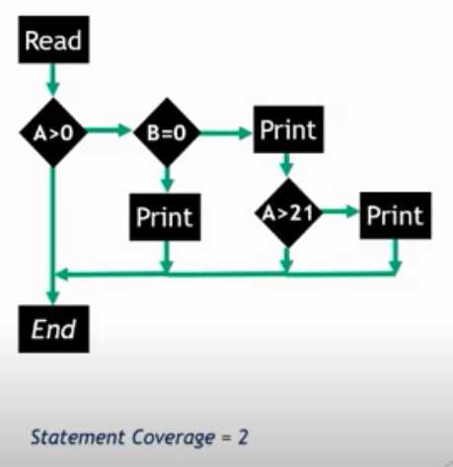
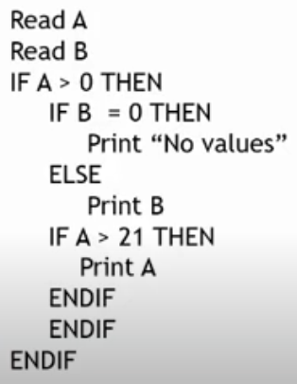
Statement Coverage Testing Example 3 (With Nested Conditions)
Tip: SC=1+No. of else= 2

Slide 11
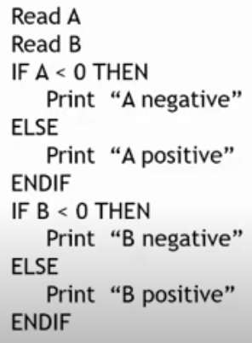
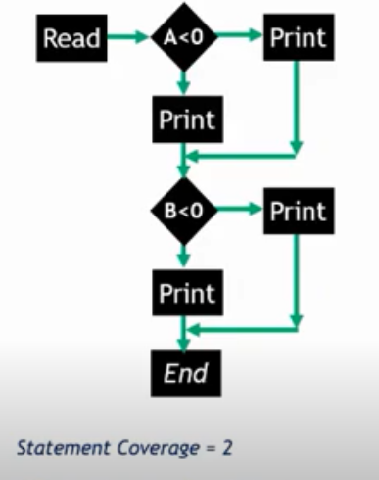
Statement Coverage Testing Example 3 (Without Nested Conditions)
Tip: SC =2 (When else are there)

Slide 12
Advantages and Disadvantages of Statement Coverage Testing
Advantage of statement coverage:
It verifies what the written code is expected to do and not to do
It measures the quality of code written
It checks the flow of different paths in the program and it also ensure that whether those path are tested or not.
Disadvantage of statement coverage:
It cannot test the false conditions.
It does not report that whether the loop reaches its termination condition.
It does not understand the logical operators.

Slide 13

Decision/Branch Coverage Testing
Decision:
'A program point at which the control flow has two or more alternative routes. Anode with two or more links to separate branches. (ISTQB Def)
Decision Coverage:
‘The percentage if the decision outcomes that have been exercised by a test suite. 100% decision coverage implies both 100% branch coverage and 100%statement coverage.‘ (ISTQB Def)
A decision is an IF statement, a loop control statement (e.g. DO-WHILE or REPEAT-UNTIL), or a CASE statement
A branch is the outcome of a decision, so branch coverage simply measures which decision outcomes have been tested

Slide 14
Decision Coverage Testing
It covers both the true and false conditions unlikely the statement
coverage.
The branch coverage can be calculated as :
Branch coverage = (number of executed branches / total number of branches) × 100%
Empty ELSE-parts are considered
Decision coverage: If the test cases execute both the decisions, it is called 100% decision coverage.
100% decision coverage guarantees 100% statement coverage
Branch coverage is also called C1-coverage/measure

Slide 15
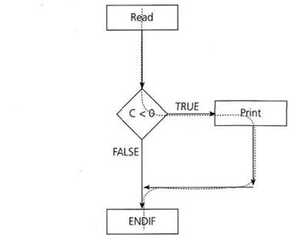
Decision Coverage Testing Example 1
1 READ A 2 READ B 3 C = A – 2 *B 4 IFC <0THEN 5 PRINT “C negative” 6 ENDIF
TIP: DC= count of if+1 (Nested if)
DC= 2 (Unnested Conditions irrespective of if)

Slide 16
Decision Coverage Testing Example 1
Test 1: A = 20, B = 15
We will get 100% statement coverage i.e we just need one test case to cover all statements.
But the above test case will not cover all the statements i.e the false one so for the decision/branch coverage we also need to coverage the empty else statements so to handle this we need another test case for the false statement.
Test 1: A = 20, B = 15 for true
Test 2: A = 10, B = 2 for false

Slide 17
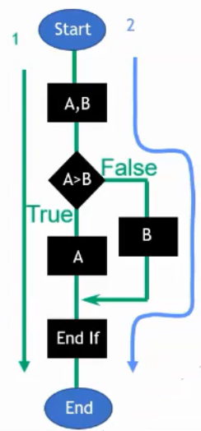
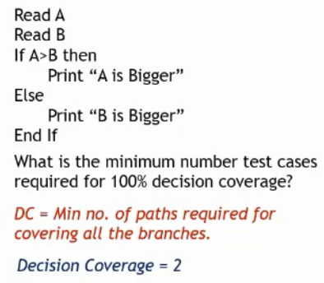
Decision Coverage Testing Example 2
TIP: DC= count of if+1 (Nested if)
DC= 2 (Unnested Conditions irrespective of if)

Slide 18
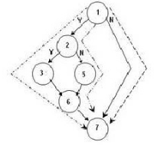
Decision Coverage Testing Example 3
If A>b
if A>c
Add A to X
else
Add A to Y
End if
End if
TIP: DC= count of if+1 (Nested if)
DC= 2 (Unnested Conditions irrespective of if)

Slide 19
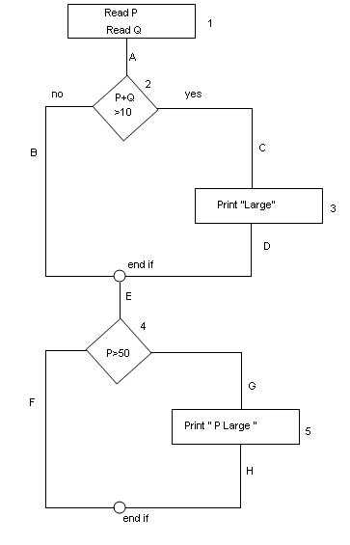
Decision Coverage Testing Example 4
Read P
Read Q
IF P+Q > 100 THEN
Print “Large”
ENDIF
If P > 50 THEN
Print “P Large”
ENDIF

Slide 20
Decision Coverage Testing Example 4
Statement Coverage: 1
1A-2C-3D-E-4G-5H
Decision Coverage: 2
1A-2C-3D-E-4G-5H ,
1A-2B-E-4F
Path Coverage: 4
1A-2B-E-4F
1A-2B-E-4G-5H
1A-2C-3D-E-4G-5H
1A-2C-3D-E-4F

Slide 21
Thank you

